Slide 1
Understanding and Configuring Networks

Slide 2
Networks
A network consists of multiple devices that communicate with one another. It can be as small as two computers or as large as billions of devices. While a traditional network is comprised of desktop computers, modern networks may include laptops, tablets, smartphones, televisions, gaming consoles, smart appliances, and other electronics.
Many types of networks exist, but they fall under two primary categories: LANs and WANs.

Slide 3
LAN (Local Area Network)
A local area network is limited to a specific area, such as a home, office, or campus. A home network may have a single router that offers both wired and wireless connections. For example, a computer may connect to the router via Ethernet, while smartphones and tablets connect to the router via Wi-Fi. All devices connected to the router share the same network and often the same Internet connection.
A larger network, such as the network of an educational institution, may be comprised of many switches, hubs, and Ethernet cables. It may also include multiple wireless access points and wireless repeaters that provide wireless access to the network. While this type of network is much more complex than a home network, it is still considered a LAN since it is limited to a specific location.

Slide 4
WAN (Wide Area Network)
A wide area network is not limited to a single area, but spans multiple locations. WANs are often comprised of multiple LANs that are connected over the Internet. A company WAN, for example, may extend from the headquarters to other offices around the world. Access to WANs may be limited using authentication, firewalls, and other security measures. The Internet itself is the largest WAN since it encompasses all locations connected to the Internet.

Slide 5
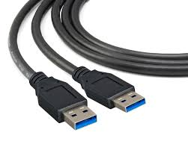
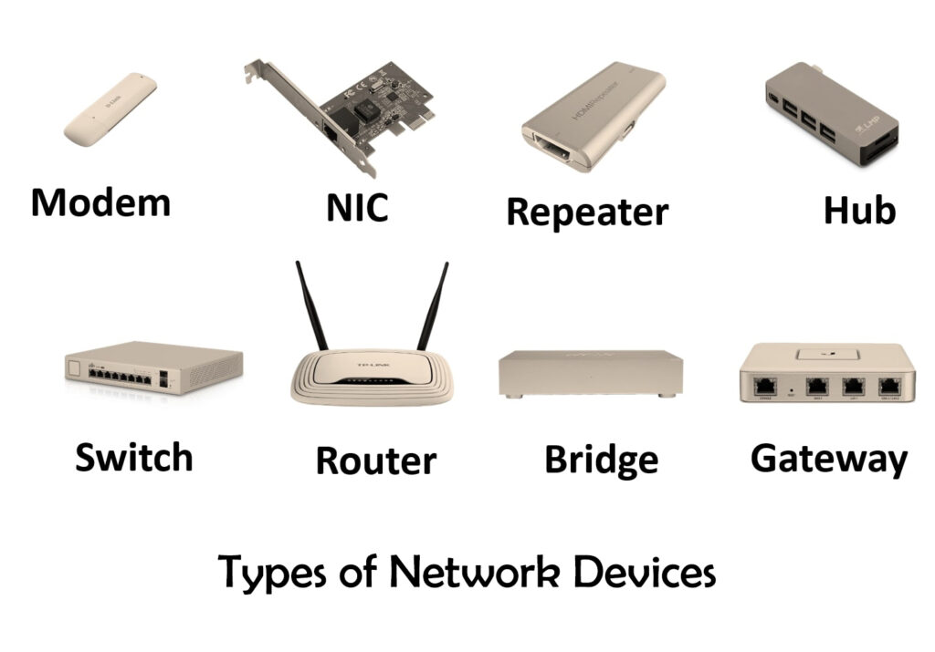
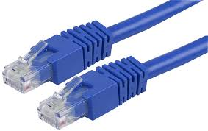
Network Components
The components of a network are
Network Interface Card (NIC)
Transport medium (cables or wireless medium)
Hubs
Bridges
Switches
Routers

Slide 6
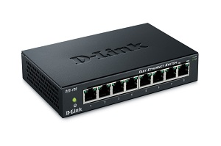
Hubs
A common connection point in a network
Hub does not filter data, so it sends the packets it receive to all connected devices/computers
Not suitable for large networks due to wasteful transmission which cause traffic congestion

Slide 7
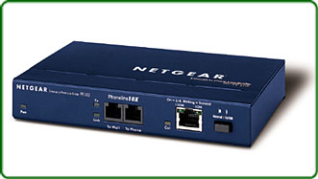
Bridge
Connects a local area network (LAN) to another LAN
Unlike a hub, bridges look at the destination of a packet before forwarding it, and it will send a packet to a destination only if the packet was meant for the given destination
Also, unlike hubs, bridges normally have only two ports, one for receiving data and the other for sending data
Bridges are typically used to connect two networks which have different architectures (ex. An Ethernet network to a Token ring segment)
Bridges are not used much anymore as switches provide more efficient data transmission and collision relief

Slide 8
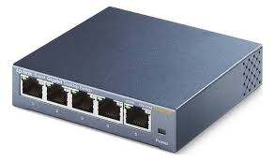
Switch
Similar to a hub, a switch serves as a central connection point for the devices on a network
Unlike a hub, a switch keeps a record of the address of all the devices that are connected to it; therefore, when it receives a packet, it forwards it to the intended destination
Unlike a bridge, a switch has multiple ports
Unlike hubs and bridges, switches also check packets for errors before forwarding them

Slide 9
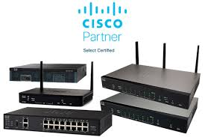
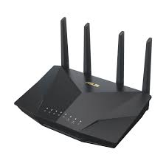
Router
A router connects multiple devices to a network and the internet, directing data packets to their correct destination and allowing devices to communicate with each other.
It acts as a central hub, creating a local area network (LAN) from an internet connection provided by a modem and distributing it to devices like computers, phones, and smart TVs, often wirelessly through Wi-Fi.
Routers also provide security by acting as a firewall, protecting the network from external threats.
ASUS RT-AX5400 WiFi Router

Slide 10
Key functions of a router
Connects devices: It creates a local network (LAN) that allows all your devices, both wired and wireless, to connect to each other and the internet.
Manages traffic: It directs data packets to the correct destination, ensuring that information sent from your computer goes to the correct website or service, and not to another device on your network.
Distributes internet connection: It takes the single internet connection from your modem and shares it across multiple devices, allowing them to all access the internet at the same time.
Provides security: Most routers include a built-in firewall that inspects incoming data and blocks malicious traffic, providing a layer of security between your network and the internet.
Enables wireless connectivity: Wireless routers create a Wi-Fi network, allowing devices to connect to the internet without cables.
Prioritizes traffic: Some routers can prioritize certain data streams over others, for example, giving your gaming console or a video conference priority over a device that is downloading a large file.

Slide 11
Differences between Routers and Switches
Feature | Switch | Router
Primary Function | Function Connects multiple devices within the same local network (LAN). | Connects different networks (e.g., LAN to WAN/Internet) and routes traffic between them.
OSI Layer | Primarily Layer 2 (Data Link Layer). | Primarily Layer 3 (Network Layer).
Addressing | Uses Media Access Control (MAC) addresses to forward data frames. | Uses Internet Protocol (IP) addresses to route data packets.
Network Scope | Local (within a single broadcast domain or VLANs). | Inter-network (across multiple broadcast domains and subnets).
Security Features | Basic port security, MAC filtering, VLANs. | Advanced features like built-in firewalls, Network Address Translation (NAT), and VPN support.
Speed | Optimized for very high-speed, low-latency local traffic. | Focuses on intelligent path selection and managing traffic across potentially different speed networks; speed depends heavily on the uplink.
Ports | Typically many ports (8, 24, 48) for connecting wired LAN devices. | Fewer LAN ports (typically 4 or 5 on a home router), plus a dedicated Wide Area Network (WAN) port for internet connectivity.

Slide 12
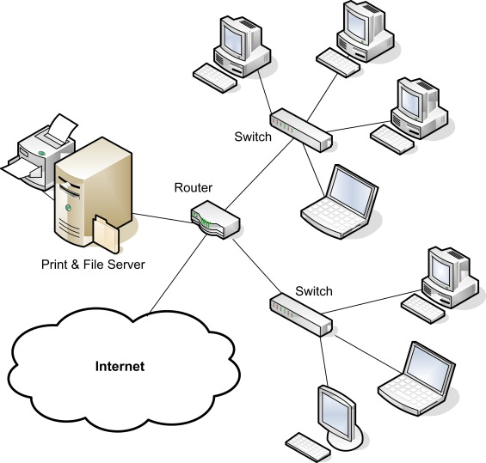
Peer-to-Peer Networks
A peer-to-peer network is an IT infrastructure in which two or more computer systems connect in order to share resources.
Workplaces may set up this type of network by physically connecting computers into a linked system or creating a virtual network. You can also set up computers to be the clients and servers of their network.
Each device in the network is considered to be a peer with functions that contribute to the network.
Each device in a P2P network shares a part of its resources with other networked computers. These resources can include storage, bandwidth and processing power.
A P2P network is different from the client-server network that people have traditionally used in networking. network.

Slide 13
Some major features of P2P networks include:
Each device in a P2P network gives resources to the network and consumes resources that the network provides.
In a P2P network, files are shared between the different computers.
Being a part of a P2P network enables sharing equipment such as printers between the various devices in the network.
The setup of a peer-to-peer network requires specialized software.
Some P2P networks are formed by overlaying a virtual network on a physical network. The network uses the physical connection to transfer data while the virtual overlay allows the computers on the network to communicate with each other.

Slide 14
Key advantages of a P2P network
Due to its architecture, a P2P network can offer many advantages to its users, including:
Easy file sharing: An advanced P2P network can share files quickly over large distances.
Reduced costs: There is no need to invest in a separate computer for a server when setting up a P2P network.
Adaptability: P2P network extends to include new clients easily. This benefit makes these networks more flexible than client-server networks.
Reliability: Unlike a client-server network, which can fail if the central server malfunctions, a P2P network will likely remain functional even if the central server crashes.
High performance: While a client-server network performs less effectively when more clients join the network, a P2P network can improve its performance when more clients join it. This is due to the fact that each client in a P2P network is also a server that contributes resources to the network.
Efficiency: Emerging P2P networks enable collaboration between devices that have different resources that can benefit the whole network.

Slide 15
Levels of P2P networking
There are three basic levels of P2P networking:
The basic level uses a universal serial bus (USB) to create a basic P2P network between two computer systems.
The intermediate level requires using copper wires to connect a large number of computers.
Finally, in an advanced P2P network, software establishes protocols that manage the direct connections between multiple devices over the internet.

Slide 16
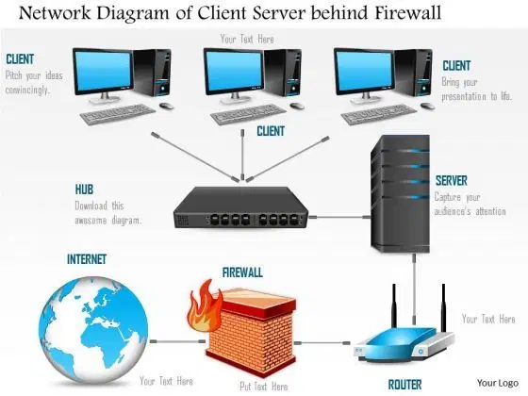
Client/Server Networking
A client/server network is a system where one or more computers called clients connect to a central computer named a server to share or use resources.
Each client computer must use an operating system that allows it to be identified to participate in the network.
Besides the computers, other types of devices can be part of the network:
Another big advantage of a client/server network is that security is created, managed, and enforced centrally. To access the network, a person, called a user must provide some credentials, such as a username and a password. The server authenticates the user. If the credentials are not valid, the user is prevented from accessing the network.

Slide 17
Client/Server Networking continued
In a client/server environment, each computer still holds (or can still hold) its (or some) resources and files. Other computers can also access the resources stored in a computer, as in a peer-to-peer scenario after they have been authenticated.
One of the particularities of a client/server network is that the files and resources are centralized. This means that a computer, the server, can hold them and other computers can access them. Since the server is always ON, the client machines can access the files and resources without caring whether a certain computer is ON.
One of the consequences of a client/server network is that, if the server is turned OFF, its resources and sometimes most of the resources on the network are not available. Most client/server configurations include server redundancy to ensure that users can access the network and its resources even if one server goes down.
The client/server type of network also provides many other advantages such as centralized backup, Intranet capability, Internet monitoring, etc. In a small network, all these services can be handled by one server:
In a medium to large network, there can be many servers, each performing a different task:

Slide 18
Network Protocols
A network protocol is an established set of rules that determine how data is transmitted between different devices in the same network. Essentially, it allows connected devices to communicate with each other, regardless of any differences in their internal processes, structure or design. Network protocols are the reason you can easily communicate with people all over the world, and thus play a critical role in modern digital communications.
Similar to the way that speaking the same language simplifies communication between two people, network protocols make it possible for devices to interact with each other because of predetermined rules built into devices’ software and hardware. Neither local area networks (LAN) nor wide area networks (WAN) could function the way they do today without the use of network protocols.

Slide 19
Communication Protocols
Common types of communication protocols include the following:
Automation: These protocols are used to automate different processes in both commercial and personal settings, such as in smart buildings, cloud technology or self-driving vehicles.
Instant messaging: Instantaneous, text-based communications on smartphones and computers occur because of a number of different instant messaging network protocols.
Routing: Routing protocols permit communication between routers and other network devices. There are also routing protocols specifically for ad hoc networks.
Bluetooth: Ever-popular Bluetooth devices — including headsets, smartphones and computers — work due to a variety of different Bluetooth protocols.
File transfer: If you have ever moved files from one device to another, either via a physical or digital medium, you’ve used file transfer protocols (FTP).
Internet Protocol: Internet Protocol (IP) allows data to be sent between devices via the internet. The internet could not operate as it currently does without IP.

Slide 20
Network Management Protocols
Network management protocols define and describe the various procedures needed to effectively operate a computer network. These protocols affect various devices on a single network — including computers, routers and servers — to ensure each one, and the network as a whole, perform optimally.
The functions of network management protocols include the following:
Connection: These protocols establish and maintain stable connections between different devices on the same network.
Link aggregation: Link aggregation protocols allow you to combine multiple network connections into one link between two devices. This works to increase the strength of the connection and helps sustain the connection should one of the links fail.
Troubleshooting: Troubleshooting protocols allow network administrators to identify errors affecting the network, evaluate the quality of the network connection, and determine how administrators can fix any issues.

Slide 21
Security Protocols
Security protocols, also called cryptographic protocols, work to ensure that the network and the data sent over it are protected from unauthorized users.
Common functions of security network protocols include the following:
Encryption: Encryption protocols protect data and secure areas by requiring users to input a secret key or password in order to access that information.
Entity Authentication: Entity authentication protocols create a system that requires different devices or users on a network to verify their identity before accessing secure areas.
Transportation: Transportation security protocols protect data while it is transported from one network device to another.

Slide 22
Network Protocol Example
Hypertext Transfer Protocol (HTTP): This Internet Protocol defines how data is transmitted over the internet and determines how web servers and browsers should respond to commands. This protocol (or its secure counterpart, HTTPS) appears at the beginning of various URLs or web addresses online.
Secure Socket Shell (SSH): This protocol provides secure access to a computer, even if it’s on an unsecured network. SSH is particularly useful for network administrators who need to manage different systems remotely.
Short Message Service (SMS): This communications protocol was created to send and receive text messages over cellular networks. SMS refers exclusively to text-based messages. Pictures, videos or other media require Multimedia Messaging Service (MMS), an extension of the SMS protocol.

Slide 23
Transport Control Protocol / Internet Protocol (TCP/IP)
TCP and IP are two separate computer network protocols.
IP is the part that obtains the address to which data is sent. TCP is responsible for data delivery once that IP address has been found.
Think of it this way: The IP address is like the phone number assigned to your smartphone. TCP is all the technology that makes the phone ring, and that enables you to talk to someone on another phone. They are different from one another, but they are also meaningless without one another.

Slide 24
How Does TCP/IP Work
TCP/IP puts a lot of emphasis on accuracy, and it has several steps to ensure that data is correctly transmitted between the two computers.
If the system were to send the whole message in one piece, and if it were to encounter a problem, the whole message would have to be re-sent. Instead, TCP/IP breaks each message into packets, and those packets are then reassembled on the other end. In fact, each packet could take a different route to the other computer, if the first route is unavailable or congested.

Slide 25
How Does TCP/IP Work
In addition, TCP/IP divides the different communications tasks into layers. Each layer has a different function. Data goes through four individual layers before it is received on the other end (as explained in the next section). TCP/IP then goes through these layers in reverse order to reassemble the data and to present it to the recipient.
The purpose of the layers is to keep things standardized, without numerous hardware and software vendors having to manage communication on their own. It’s like driving a car: All the manufacturers agree on where the pedals are, so that’s something we can count on between cars. It also means that certain layers can be updated, such as to improve performance or security, without having to upgrade the entire thing.

Slide 26
Packets
A packet is a small amount of data sent over a network, such as a LAN or the Internet. Similar to a real-life package, each packet includes a source and destination as well as the content (or data) being transferred. When the packets reach their destination, they are reassembled into a single file or other contiguous block of data.
While the exact structure of a packet varies between protocols, a typical packet includes two sections — a header and payload. Information about the packet is stored in the header. For example, an IPv6 header includes the following fields:
Source address (128 bits) - IPv6 address of the packet origin
Destination address (128 bits) - IPv6 address of the packet destination
Version (4 bits) - "6" for IPv6
Traffic class (8 bits) - priority setting for the packet
Flow label (20 bits) - optional ID that labels the packet as part of a specific flow; used to distinguish between multiple transmissions from a single origin
Payload length (16 bits) - size of the data, defined in octets
Next header (8 bits) - ID of the header following the current packet; may be TCP, UDP, or another protocol
Hop limit (8 bits) - maximum number of network hops (between routers, switches, etc) before the packet is dropped; also known as "TTL" in IPv4

Slide 27
Packets - Payload
The payload section of a packet contains the actual data being transferred. This is often just a small part of a file, webpage, or other transmission, since individual packets are relatively small. For example, the maximum size of an IP packet payload is 65,535 bytes, or 64 kilobytes. The maximum size of an Ethernet packet or "frame" is only 1,500 bytes or 1.5 kilobytes.
Packets are intended to transfer data reliably and efficiently. Instead of transferring a large file as a single block of data, sending smaller packets helps ensure each section is transmitted successfully. If a packet is not received or is "dropped," only the dropped packet needs to be resent. Additionally, if a data transfer encounters network congestion due to multiple simultaneous transfers, the remaining packets can be rerouted through a less congested path.

Slide 28
Are my data packets private?
No. When the packets are being transmitted between computers, they are vulnerable to being seen by others. That’s one reason why you are advised to avoid public Wi-Fi networks when sending data that must stay private, and to use.
If this is something you are concerned about – for example, if you’re sending personally identifiable information or financial information – you can encrypt your data using a virtual private network (VPN).
A VPN is the best way to ensure your data is effectively encrypted and packets are protected as they travel between networks. You can set up a VPN manually, or try one of many free or pay to use third party VPNs.

Slide 29
IPv4
IPv4 is the most widely used version of the Internet Protocol.
It defines IP addresses in a 32-bit format, which looks like
123.123.123.123.
Each three-digit section can include a number from 0 to 255, which means the total number of IPv4 addresses available is 4,294,967,296 (256 x 256 x 256 x 256 or 2^32).
Each computer or device connected to the Internet must have a unique IP address in order to communicate with other systems on the Internet. Because the number of systems connected to the Internet is quickly approaching the number of available IP addresses, IPv4 addresses are predicted to run out soon. When you consider that there are over 6 billion people in the world and many people have more than one system connected to the Internet (for example, at home, school, work, etc.), it is not surprising that roughly 4.3 billion addresses is not enough.
To solve this problem, a new 128-bit IP system, called IPv6, has been developed and is in the process of replacing the current IPv4 system. During this transitional process from IPv4 to IPv6, systems connected to the Internet may be assigned both an IPv4 and IPv6 address.

Slide 30
IPv4 on private networks
The following three blocks of IP addresses are designated to be used on private networks only:
10.0.0.0 to 10.255.255.255
172.16.0.0 to 172.31.255.255
192.168.0.0 to 192.168.255.255
These numbers cannot directly access the internet as many private networks exist and they probably all use the same numbers internally. However, the computers in a private network normally send their data through a gateway (a computer or router on their network that has a private IP address and a Public IP address) that has access to the internet.

Slide 31
IPv4 on private networks
Each computer on a network must have a unique IP address in order to be found by other computers in the network or connected networks. The IP address itself contains to identifying parts that allow us to determine what network a computer is in and what its unique number is by using a subnet mask
Example: Decimal Binary
IP Address 172.16.254.1 10101100.00010000.11111110.00000001
Subnet Mask 255.255.255.0 11111111.11111111.11111111.00000000
Network Portion
Computer Portion

Slide 32
IPv6
Every computer system and device connected to the Internet is located by an IP address. The current system of distributing IP addresses is called IPv4. However, with the growth of computers connected to the Internet, the number of available IP addresses are predicted to run out in only a few years. This is why IPv6 was introduced.
IPv6, also called IPng (or IP Next Generation), is the next planned version of the IP address system. While IPv4 uses 32-bit addresses, IPv6 uses 128-bit addresses, which increases the number of possible addresses by an exponential amount.
IPv4 allows 4,294,967,296 addresses to be used (2^32).
IPv6 allows for over 340,000,000,000,000,000,000,000,000,000,000,000,000 IP addresses. That should be enough to last awhile.

Slide 33
IPv6
Because IPv6 allows for substantially more IP addresses than IPv4, the addresses themselves are more complex. They are typically written in this format:
hhhh:hhhh:hhhh:hhhh:hhhh:hhhh:hhhh:hhhh
Each "hhhh" section consists of a four-digit hexadecimal number, which means each digit can be from 0 to 9 and from A to F. An example IPv6 address may look like this:
F704:0000:0000:0000:3458:79A2:D08B:4320
Because IPv6 addresses are so complex, the new system also adds extra security to computers connected to the Internet. Since there are so many IP address possibilities, it is nearly impossible to guess the IP address of another computer. While most computer systems today support IPv6, the new Internet procotol has yet to be fully implemented. During this transitional process, computers are often assigned both an IPv4 and an IPv6 address.

Slide 34
Command Line Utilities for testing Networks
There are a few utilities that come in handy when trying to test connectivity of nodes in a network;
ping - is a computer network administration software utility used to test the reachability of a host on an Internet Protocol (IP) network. Ping measures the round-trip time for messages sent from the originating host to a destination computer that are echoed back to the source.
tracert - is a network diagnostic tool used to track in real-time the pathway taken by a packet on an IP network from source to destination, reporting the IP addresses of all the routers it pinged in between. Traceroute also records the time taken for each hop the packet makes during its route to the destination.
nslookup - (from name server lookup) is a network administration command-line tool available in many computer operating systems for querying the Domain Name System (DNS) to obtain domain name or IP address mapping, or other DNS records.
ipconfig – command is a fast way of determining your computer’s IP address and other information, such as the address of its default gateway—useful if you want to know the IP address of your router’s web interface. This command, used with switches can modify many aspects of the systems network configuration related to IP addresses

Slide 35
Communicating over the network
You can communicate on a Windows network using the command line with the msg tool. This command allows you to send a pop-up message to another user on the network.
Open Command Prompt as administrator.
Use the following syntax:
msg USERNAME /server:SERVERNAME "Your Message".
Replace USERNAME with the user's name on the remote computer.
Replace SERVERNAME with the name of the remote computer.
For the current user on the remote computer, you can use
msg * /server:SERVERNAME "Your Message".
You can also use the IP address instead of the server name:
msg * /server:192.168.1.6 "Your Message".

